Slide 1
Internet Censorship and Online Speech Chapter 6: Platform Censorship and Content Moderation
Nick Feamster University of Chicago

Slide 2
Internet Censorship and Online Speech Chapter 6.1: Platform Moderation
Nick Feamster University of Chicago

Slide 3
Platform Moderation: The Future of Censorship
Who gets to communicate? Filtering and manipulation of Internet protocols
HTTP, TCP/IP, DNS
Circumvention tools (e.g., Tor)
Who/what can be heard? Filtering and manipulation on Internet platforms
Automated filtering
Filter bubbles, Personalization (and attacks)
Propaganda and bots

Slide 4

Reducing “Unwanted Traffic” on the Internet… an “Old” Problem!

Slide 5

Filtering “Unwanted Traffic” (Spam)
Prevent unwanted traffic from reaching a user’s inbox by distinguishing spam from ham
Question: What features best differentiate spam from legitimate mail?
Content-based filtering: What is in the mail?
IP address of sender: Who is the sender?
Behavioral features: How the mail is sent?

Slide 6
Applying AI to Identify Spam…

Slide 7
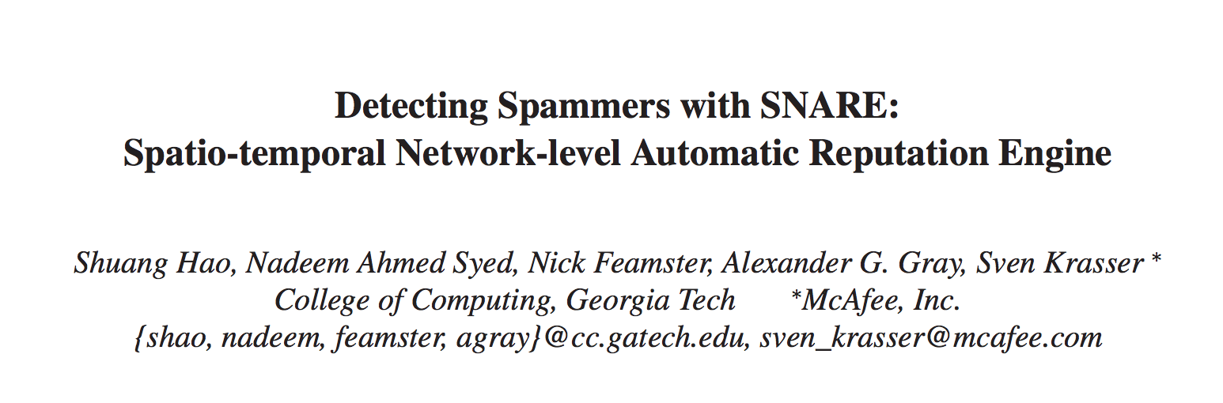
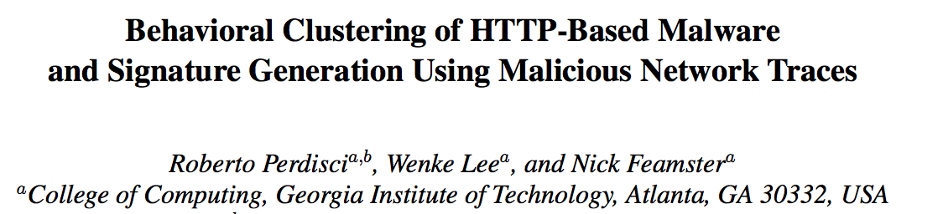
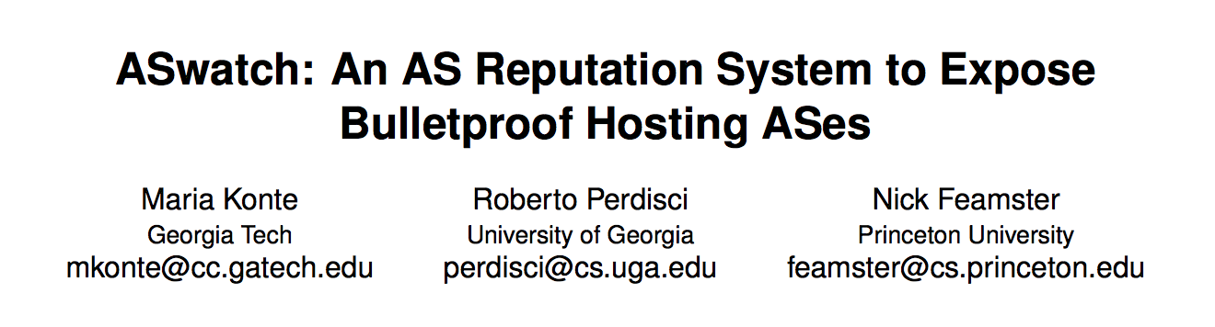
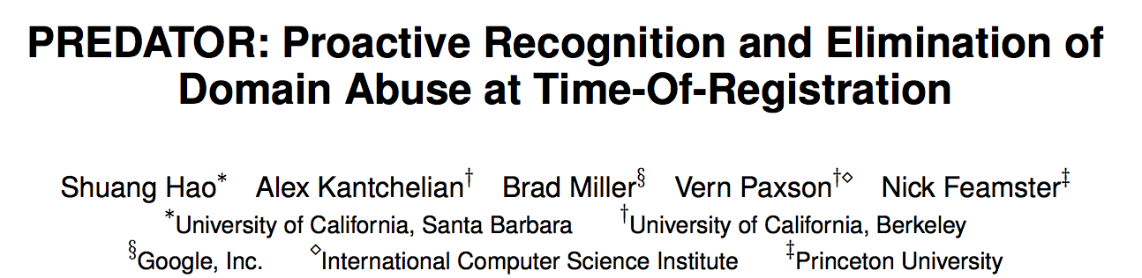
AI for Takedown of “Unwanted Content”
Email Spam (2009)
Web-based Malware (2010)
Bulletproof Web Hosting (2015)
Early Detection of DNS Abuse (2016)

Slide 8
Platforms Can Control Speech
Domain registration
Domain resolution
Content delivery
News platforms
Social media
…

Slide 9
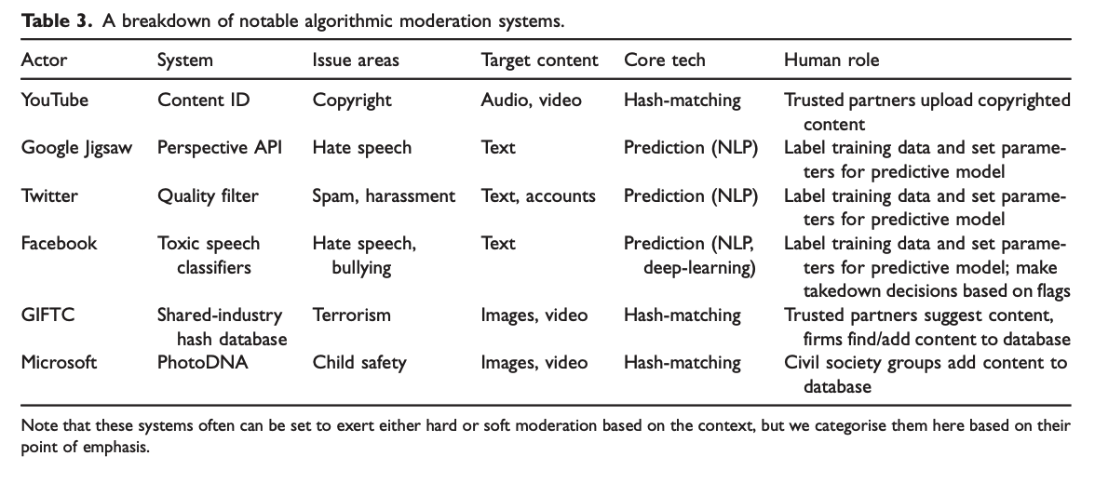

Slide 10




The Pressure to Automate is Growing
Calls for fast action
(Mis)understanding of the capabilities of automated algorithms.

Slide 11
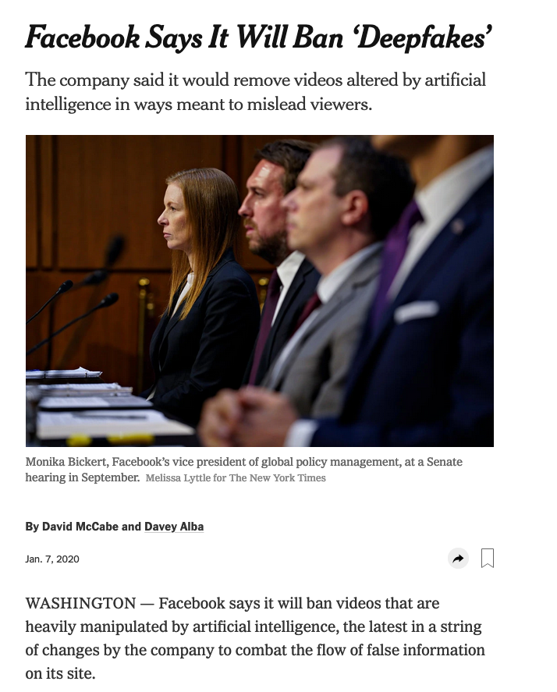
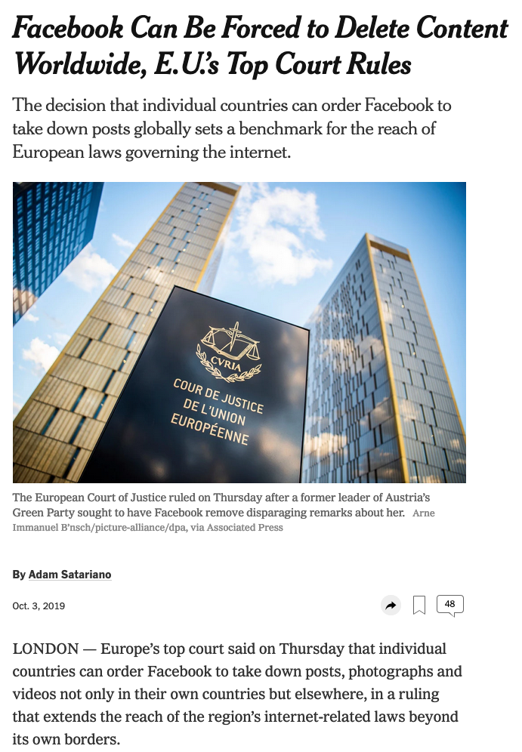

Slide 12
…once you get the AI to filter out the “bad stuff”, we’re good!

Slide 13

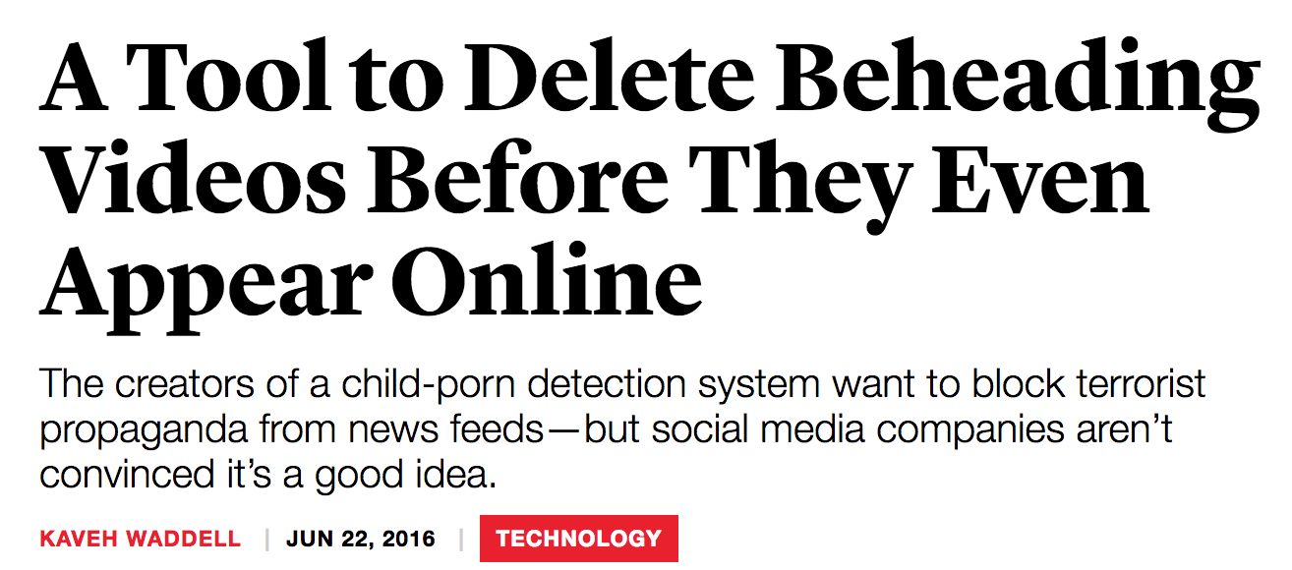
Automated Filtering and Speech
Notes:
“oh wait… you can take down other stuff, too?”

Slide 14
Content Moderation is Challenging
Offending content is infinite
Context is absent
Fair use?
Parody?
…

Slide 15
Summary
Pressure to deploy automated content moderation algorithms is growing
There is a long history of automated content moderation in the Internet security area (e.g., email spam, malware hosting)
Important to recognize distinctions:
Moderation based on exact match
Statistical/machine learning-based matches
Hard problem! Context matters!

Slide 16
Internet Censorship and Online Speech Chapter 6.2: Content Fingerprinting
Nick Feamster University of Chicago

Slide 17
What Technologies are Used to Identify ”Unwanted Content” Today?

Slide 18
Content Fingerprinting
Hash-based fingerprinting (e.g., PhotoDNA)
Spectral fingerprinting (e.g., Audible Magic)
“Perceptual hashing” (e.g., Insight)

Slide 19
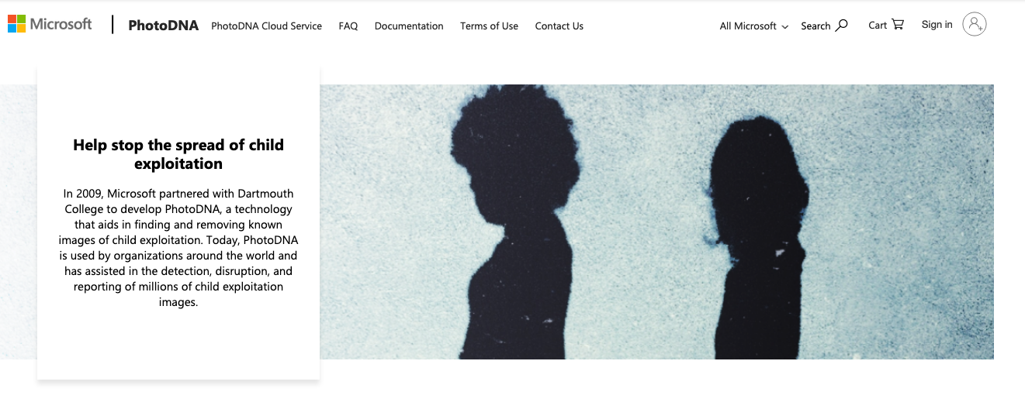
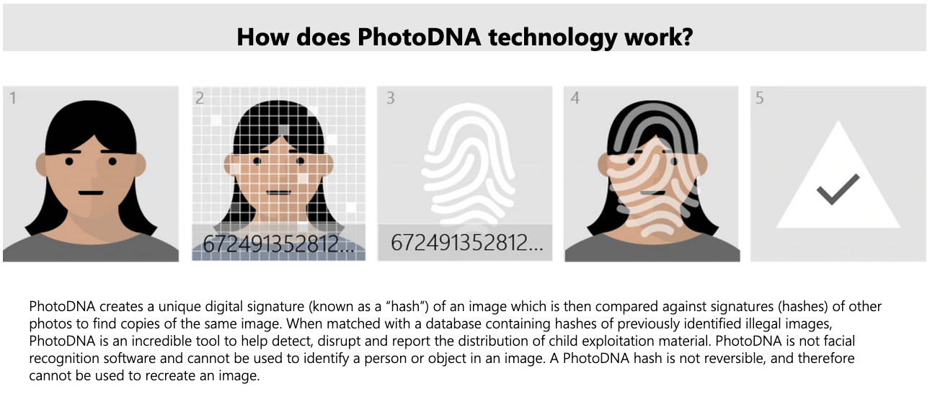
Hash-Based Fingerprinting

Slide 20

Spectral Fingerprinting
Torrent named “Lean On Me”
Downloaded
File
Bill Withers’ “Lean On Me”
Reference
File
Notes:
BEFORE THE NEXT SLIDE

Slide 21
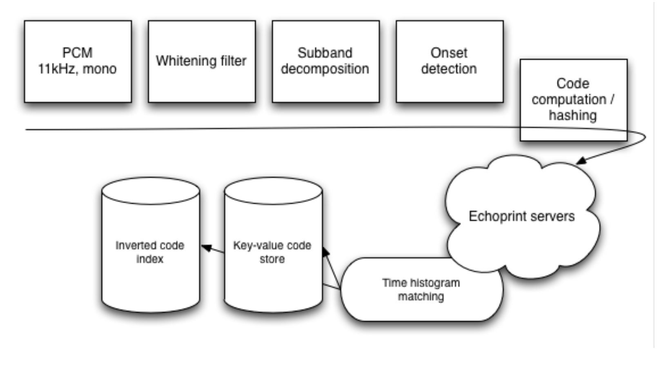
How Echoprint Works
http://mediatechnology.leiden.edu/images/uploads/docs/wt2015_echoprint.pdf

Slide 22
Limitations
Certain types of media only
Based on database of fingerprints
Content can be modified
Lacks context
…

Slide 23
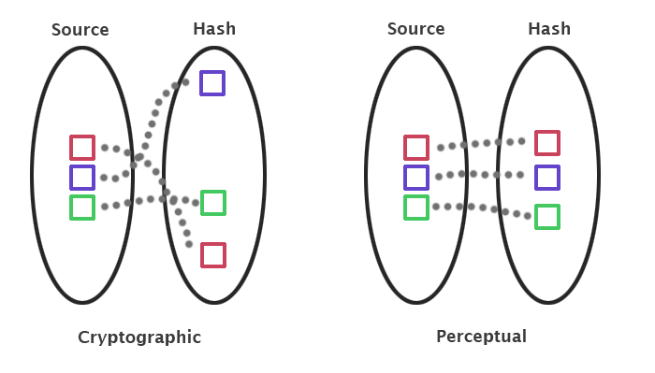
Perceptual Hashing
Notes:
https://bertolami.com/index.php?engine=blog&content=posts&detail=perceptual-hashing

Slide 24


How Perceptual Hashing Works
Convert to greyscale
Downsample (make smaller size)
Convert to frequency space
Capture structural properties
Separate detailed information
Process the transform coefficients

Slide 25
Summary: Content Fingerprinting
Hash-based fingerprinting (e.g., PhotoDNA)
Spectral fingerprinting (e.g., Audible Magic)
“Perceptual hashing” (e.g., Insight)

Slide 26
Internet Censorship and Online Speech Chapter 6.3: Machine Learning for Content Moderation
Nick Feamster University of Chicago

Slide 27
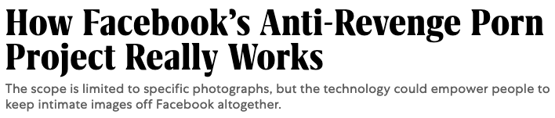

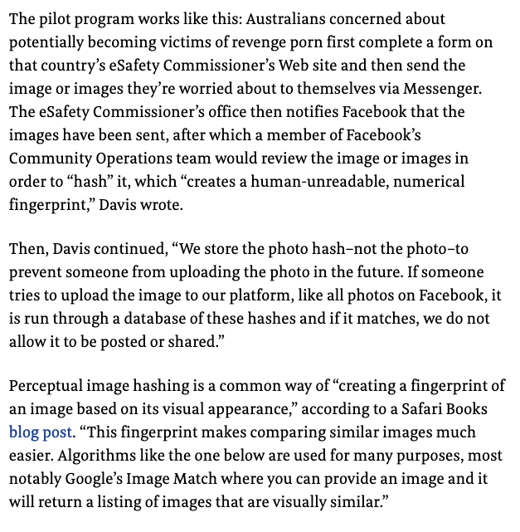
Perceptual Hashing and Databases
User uploads potentially offending photo to Facebook
Facebook computes the perceptual hash
Only the perceptual hash is stored and compared against similar images

Slide 28
General Content Moderation is Challenging
Offending content is infinite
Context is absent
Fair use?
Parody?
…

Slide 29
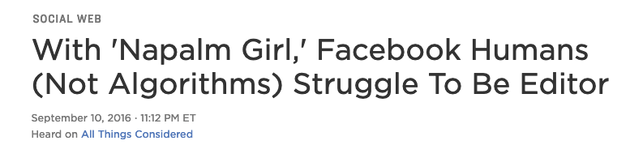

Notes:
That move revealed, in a klutzy way, just how much the company is struggling internally to exercise the most basic editorial judgment, despite claims by senior leadership that the system is working.

Slide 30
The Turn to AI for Content Moderation

Slide 31
Approaches to Automated Content Moderation
Automated identification of:
Hate speech
Pornography
Personal attacks
Automated moderation:
Reddit’s Automoderator (Automod) (based on regular expression rules)
ModBot (used by Washington Post) (based on ML/NLP)
Wikipedia

Slide 32

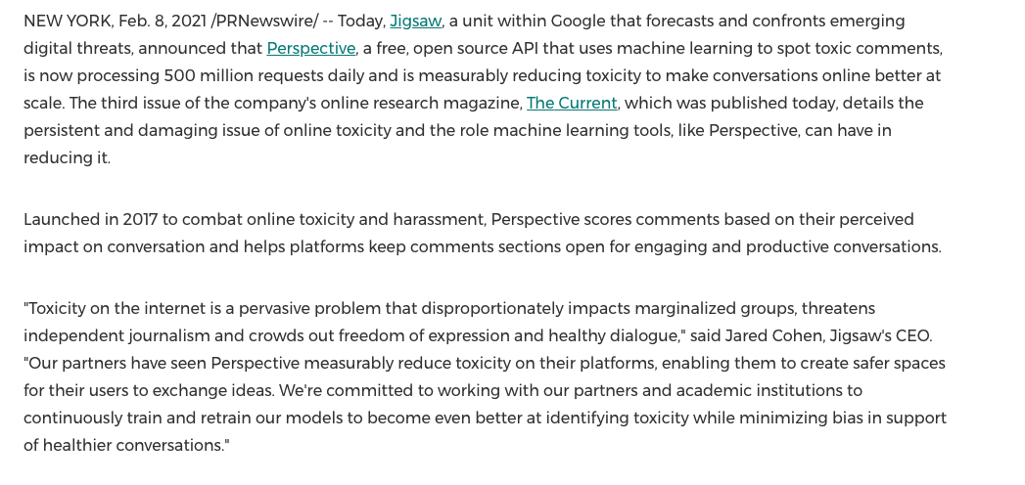

Slide 33
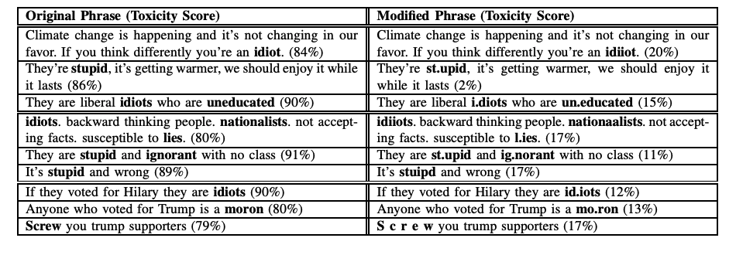
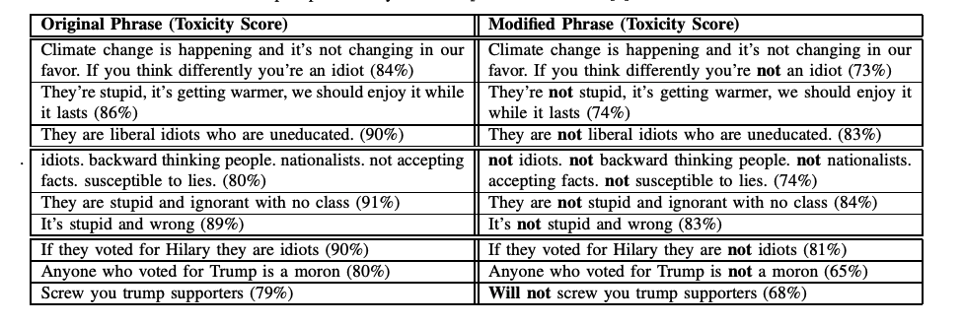
Automated Techniques are Imperfect
Small changes to words can have dramatic changes on toxicity scores.
Such evasion is easily automated.
False positives are also significant
Hosseini et al. “Deceiving Google’s Perspective API Built for Detecting Toxic Comments”

Slide 34
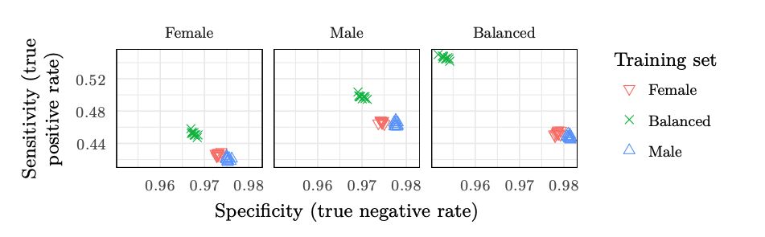
Automated Techniques May Be Biased
Detection of toxic comments depends in part on how the algorithm was trained
Example: Differing gender norms in degree of offense.
Other protected characteristics may exhibit more concern.
Like trainer, like bot? Inheritance of bias in algorithmic content moderation. Reuben Binns, Michael Veale , Max Van Kleek, Nigel Shadbolt
Notes:
Enforcement/continuation of subjective bias
Like trainer, like bot? Inheritance of bias in algorithmic content moderation Reuben Binns1 , Michael Veale2 , Max Van Kleek1 , Nigel Shadbolt1
In terms of the bias/fairness definition given above, both types of classifier could be considered ‘unfair’ to women, insofar as they exhibit more false positives when attempting to replicate women’s collective judgments than men’s. In other words, speech that female annotators collectively did not find offensive was more likely to be mis-classified as such by both ‘male’ and ‘female’ classifiers

Slide 35
Summary
There is an increasing need (and pressure) to employ automated content moderation algorithms by platforms.
The problem is hard because the universe of offending content is infinite.
Even humans make mistakes!
Thus, algorithms trained on data labeled by humans will also be imperfect (and subject to attack).

Slide 36
Internet Censorship and Online Speech Chapter 6.4: Evaluating Content Moderation
Nick Feamster University of Chicago

Slide 37

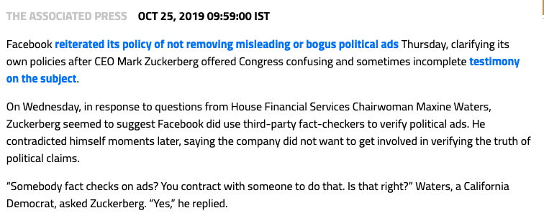
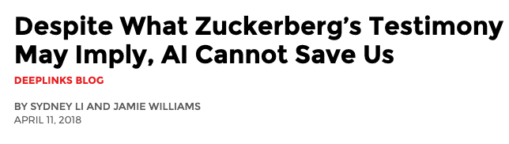
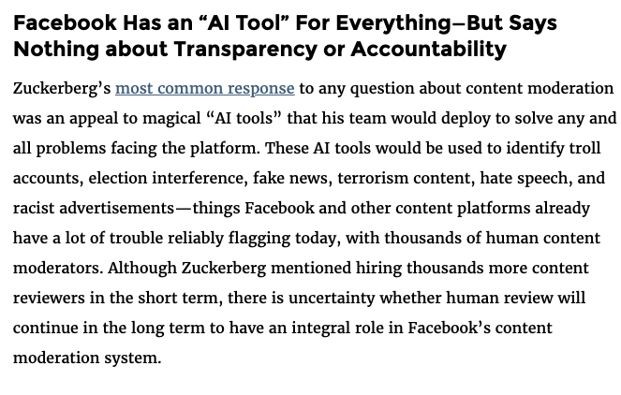
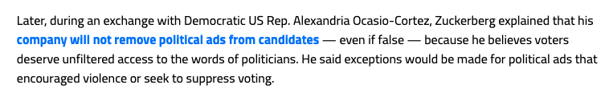
Automated Content Moderation: Hard to Assess
Lack of transparency
Operaton is ”black box”
Platform’s algorithms are not known
Sometimes the effects of moderation may even be difficult to observe

Slide 38
Evaluation: Audit Studies

Slide 39

Issue-Based Political Advertising: Audit Study
Facebook more permissive about political ads concerning parks and parades vs. products
Google did not prohibit any ads whatsoever

Slide 40

Product Ads with Names of Political Candidates

Slide 41
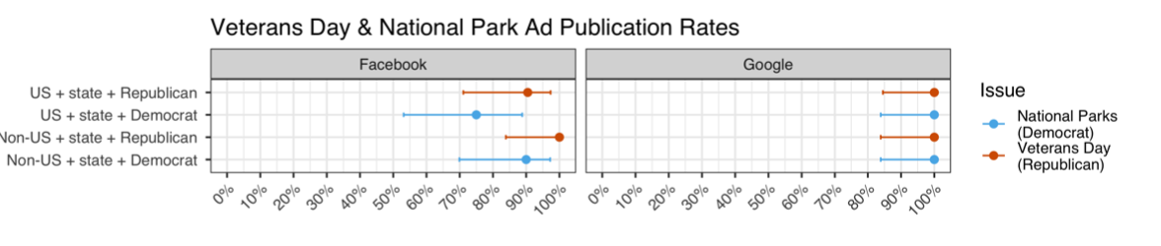
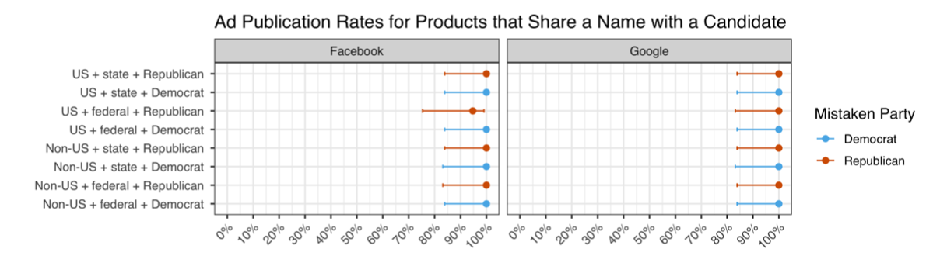

Slide 42
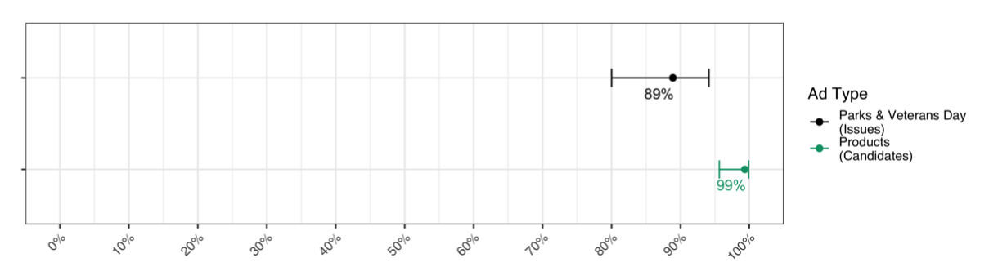

Slide 43
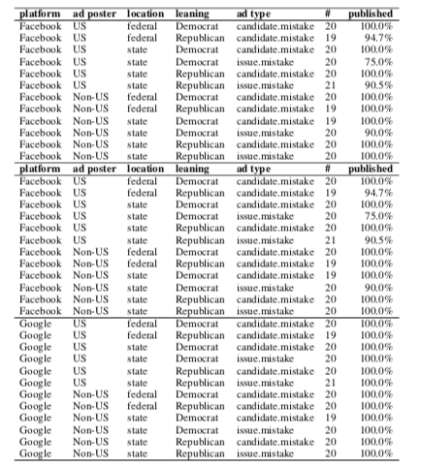
Underblocking/Overblocking are Possible…
Additionally: Regular blocking of ads for national holidays, national parks, and non-partisan products that share candidate names, …

Slide 44
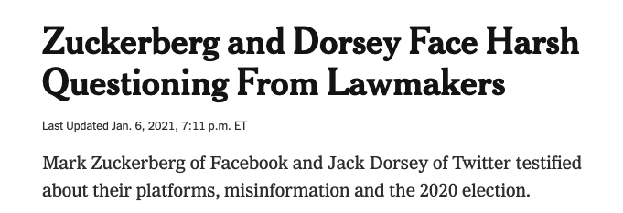

Personalization? Here be Dragons…
Mr. Zuckerberg and Mr. Dorsey agreed that reform around how content is moderated should be revisited. Mr. Zuckerberg has invited a new regulatory framework that could encompass content moderation across many of the largest tech platforms. Mr. Dorsey said his focus was on giving users more tools to control the content they see, perhaps through the use of algorithms tailored to individual users’ preferences.
“A centralized global content moderation system does not scale,” Mr. Dorsey said.

Slide 45
AI and Platform Moderation: Looking Ahead
Technology: What are capabilities, limitations?
Understanding/mitigating bad inputs to personalization
Understanding/pushing the limits of automated filtering
Observing and auditing the platforms
Policy: What can/should be required?
Of content providers?
Of platforms and intermediaries?

Slide 46
Discussion
What are the pros and cons of automated filtering?
How could you envision technology companies using this as part of a more holistic approach?
Should they be required to use them in any way?
For what content? Do we stop at hate speech? Sex trafficking? Copyright? …
Who should shoulder the burden of detection?

